Slide 1

Wildfire Prevention & Safety
Kristen Davis
Director of Account Management
760.466.7721
Kristen.davis2@gmr.net

Slide 2
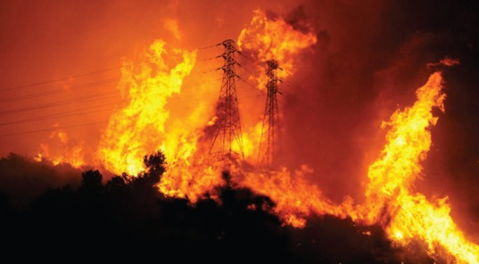
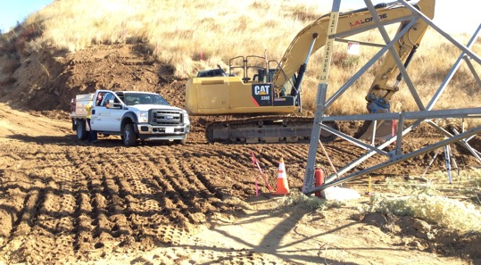
Wildfire Prevention

Slide 3
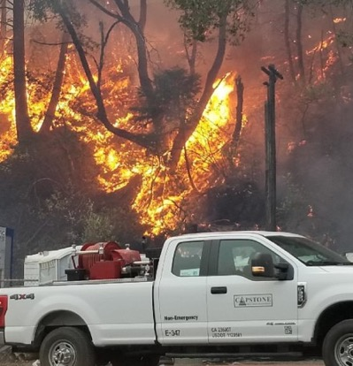
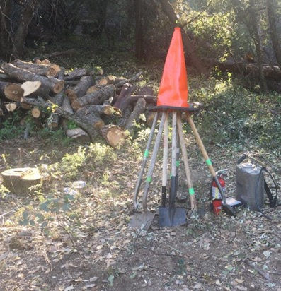
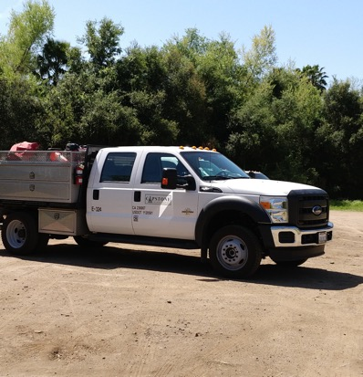
Equipment vs. Tools

Slide 4
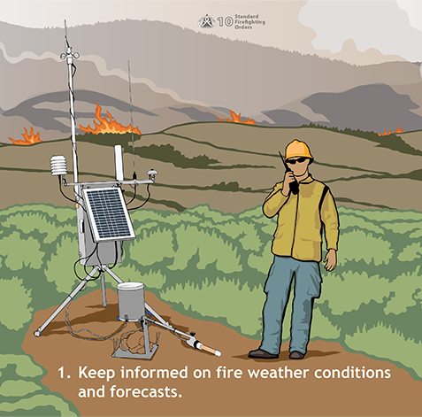
10 Standing Orders

Slide 5
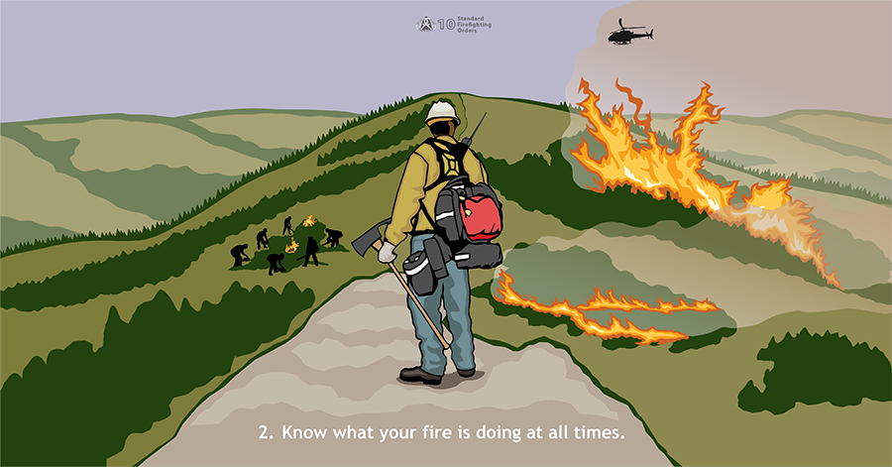

Slide 6
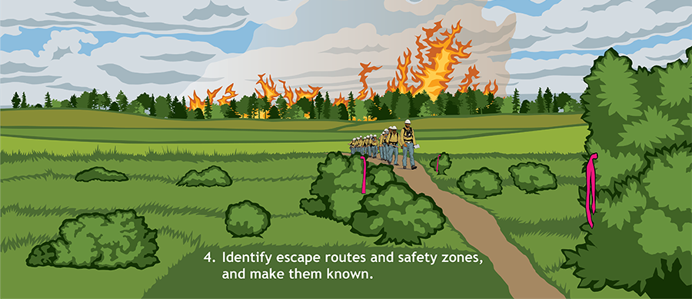

Slide 7
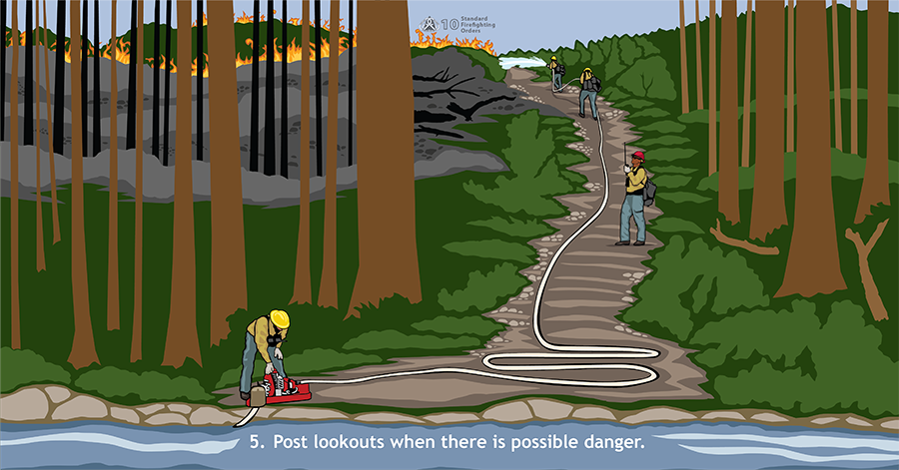

Slide 8
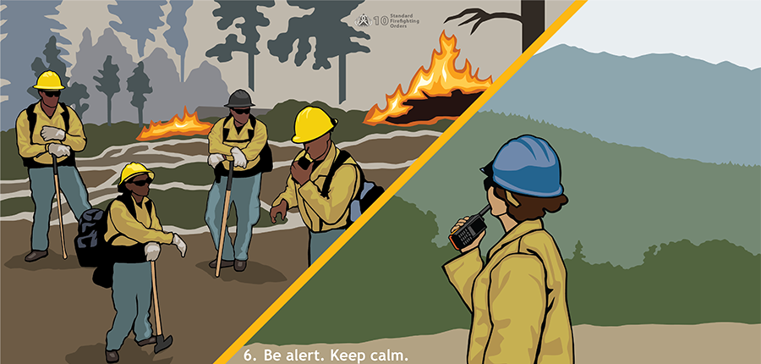

Slide 9
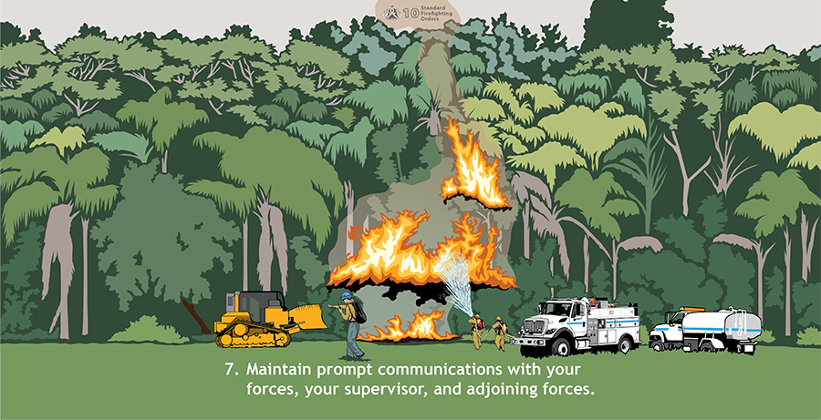

Slide 10
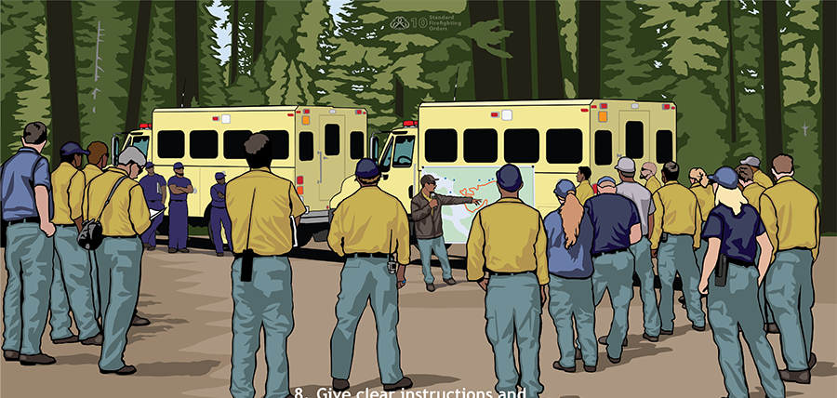

Slide 11
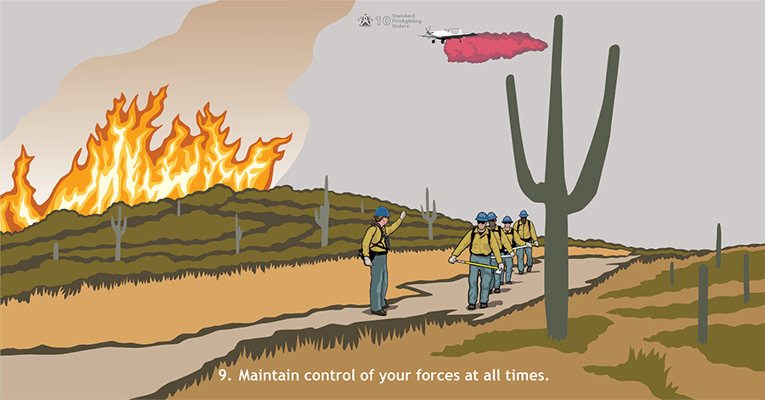

Slide 12
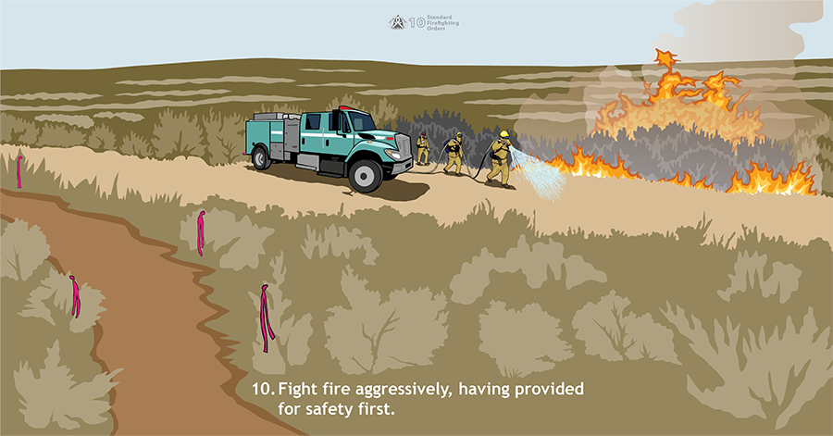

Slide 13

18 Look Outs and the importance of “LCES”
Lookouts
Communication
Escape Route
Safety Zones

Slide 14
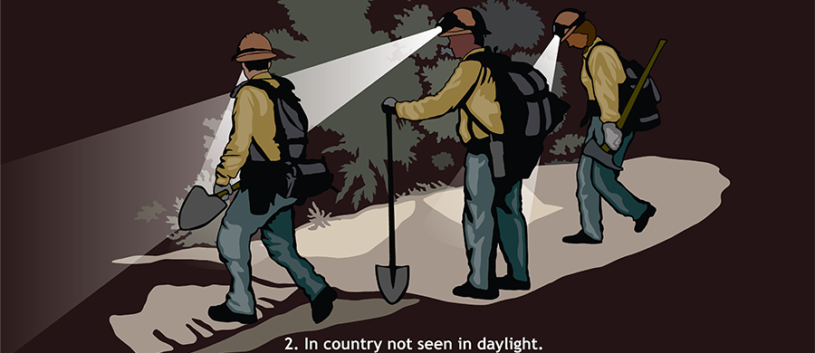

Slide 15
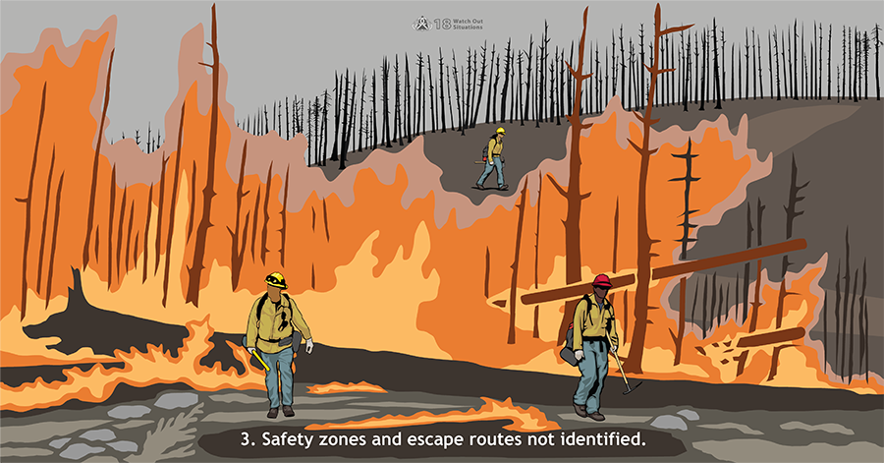

Slide 16
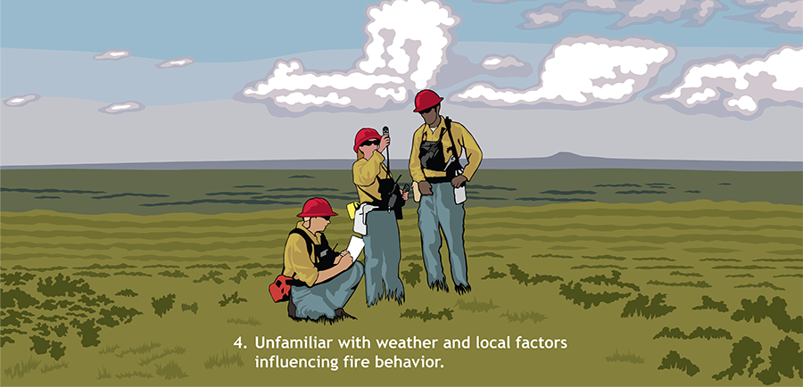

Slide 17
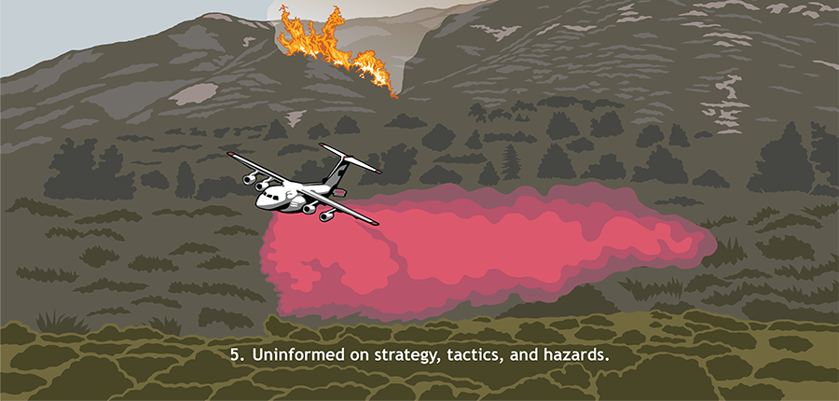

Slide 18
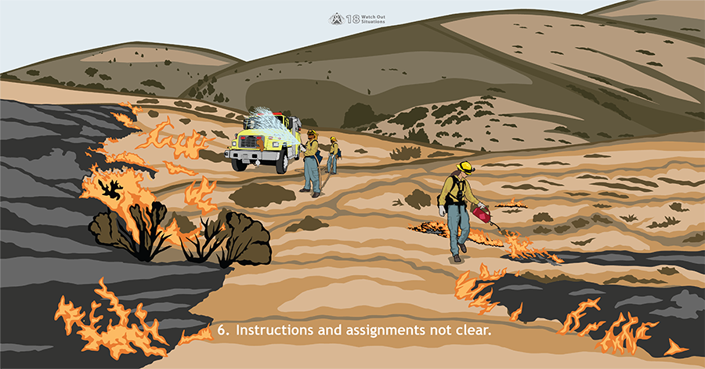

Slide 19
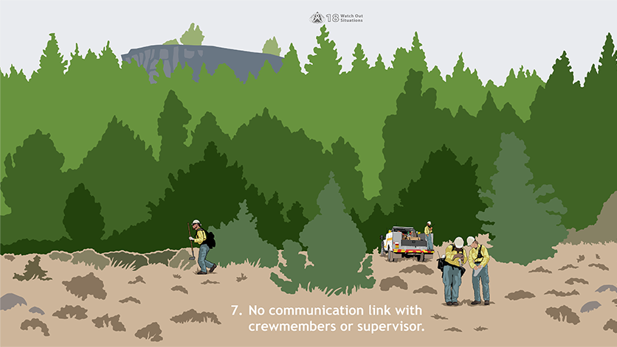

Slide 20
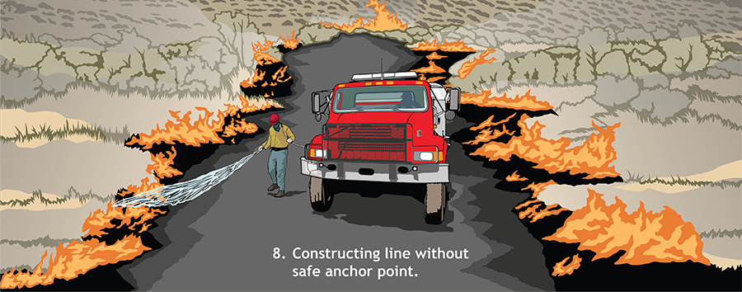

Slide 21
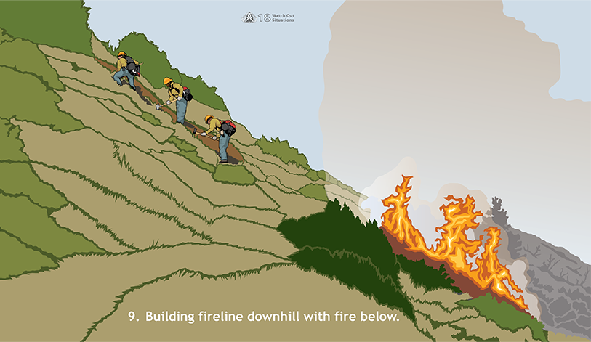

Slide 22
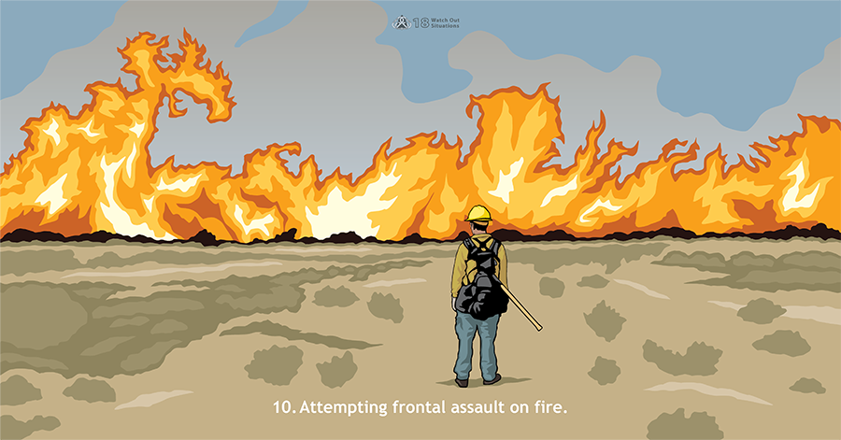

Slide 23
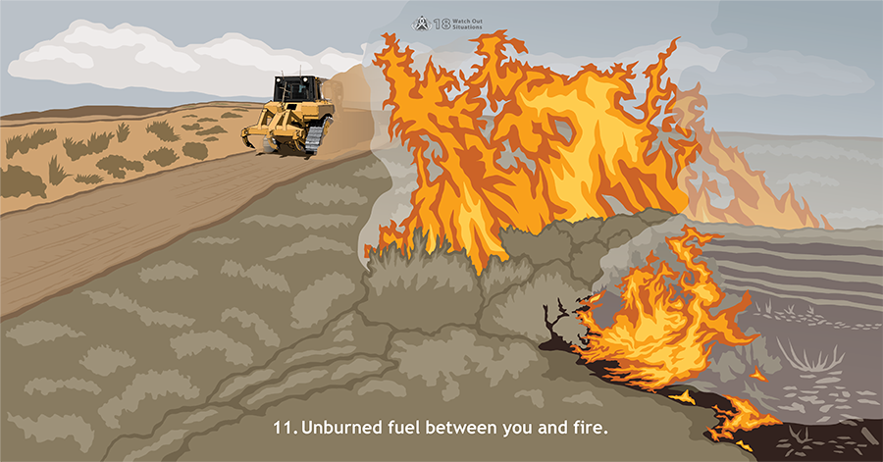

Slide 24
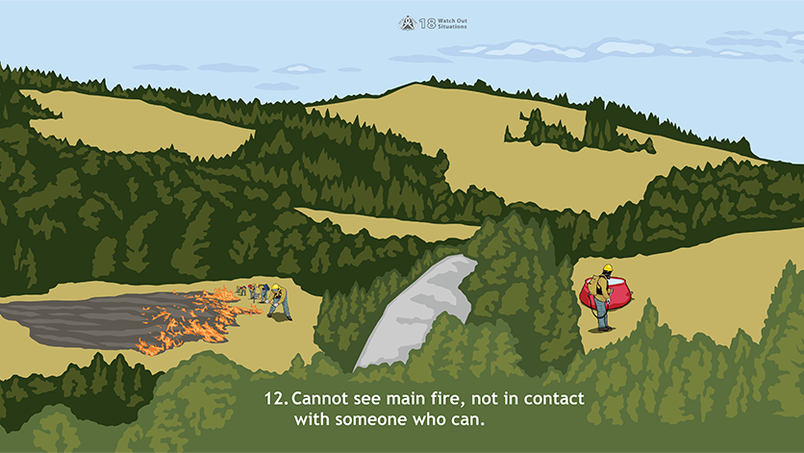

Slide 25
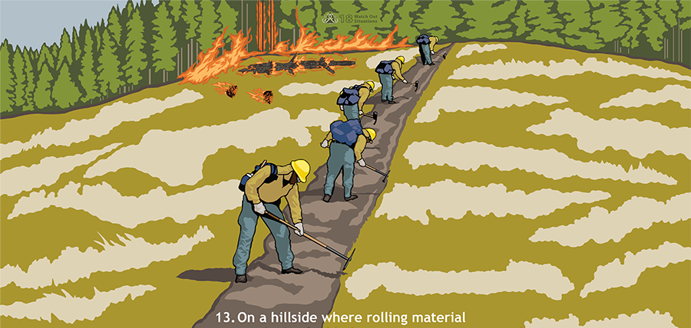

Slide 26
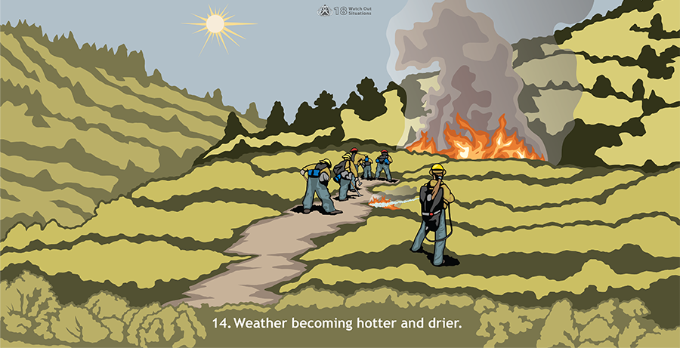

Slide 27
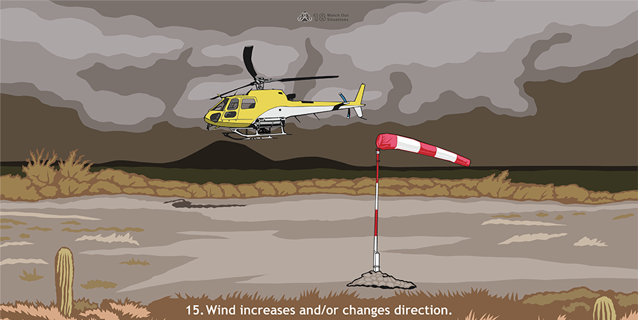

Slide 28
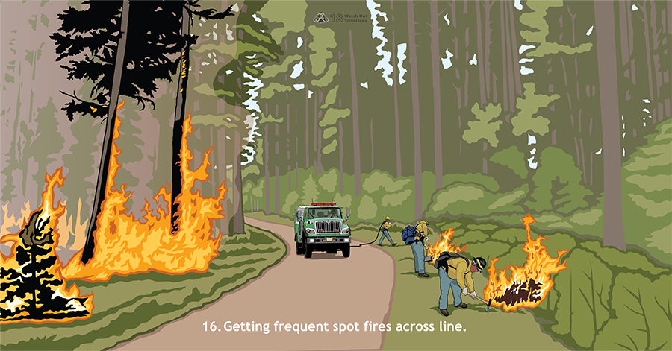

Slide 29
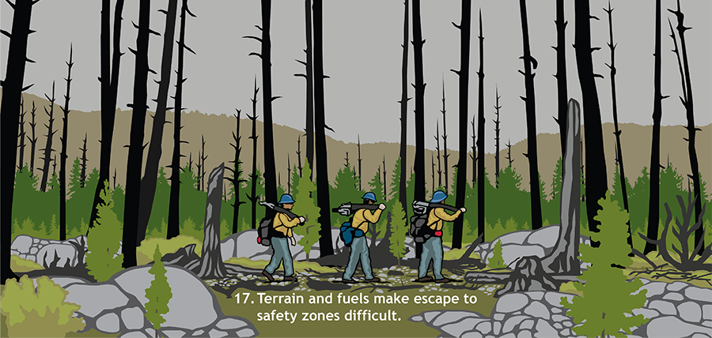

Slide 30
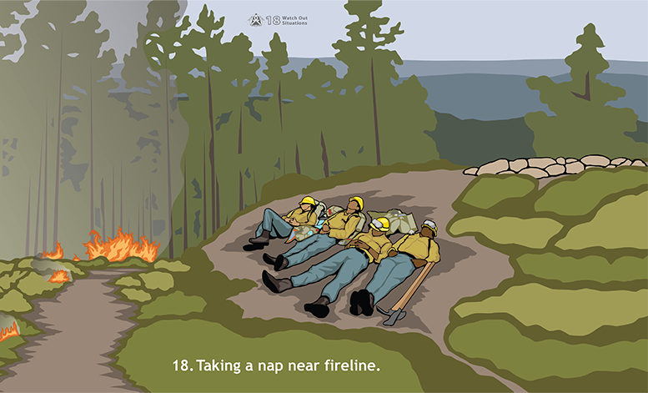

Slide 31

https://www.nwcg.gov/committees/6-Minutes-for-safety

Slide 32

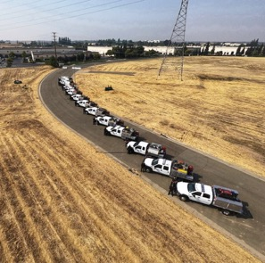
References
10 Standard Firefighting Orders, PMS 110
18 Watch Out Situations, PMS 118
10 and 18 Poster, PMS 110-18
Links
https://www.nwcg.gov/publications/pms110-18
https://nwcg.gov/committees/6-Minutes-for-safety
www.firewiseusa.org
https://shop.phos-chekhomedefense.com/PHOS-CHEK-WILDFIRE-HOME-DEFENSE
https://www.nwcg.gov/publications/training-courses/rt-130
https://www.nwcg.gov/publications/training-courses/s-190
www.capstonefire.com
www.ruralmetrofire.com
www.globalmedicalresponse.com
Presentation References & Links

